Slide 1
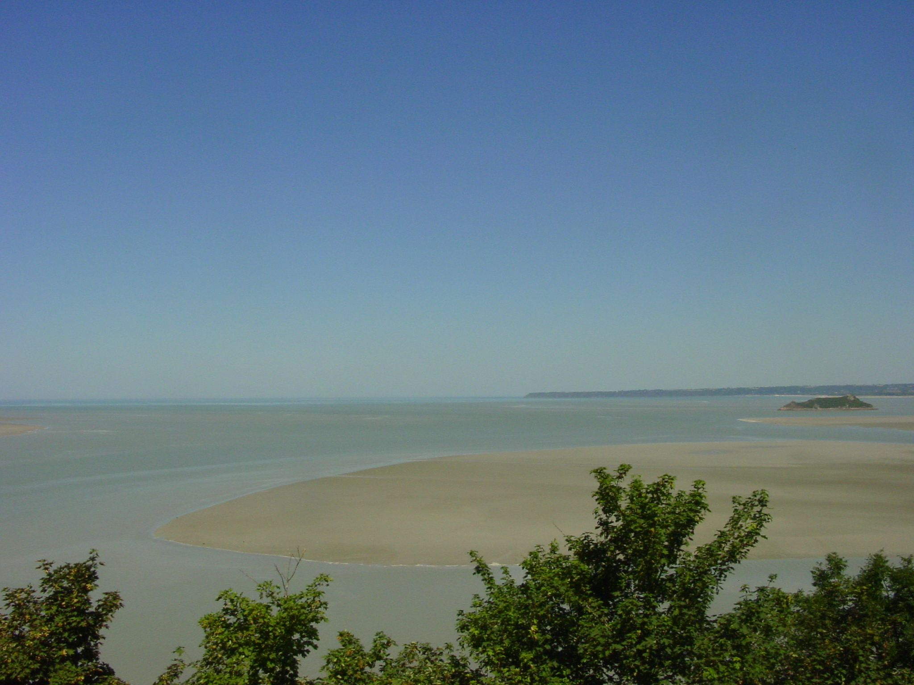
Chapter 1
Description of the climate system and of its components
Climate system dynamics and modelling Hugues Goosse

Slide 2
Outline
Presentation of the main components of the climate system
Description of some processes that will be useful in the next chapters.
Chapter 1 Page 2

Slide 3
Definition of climate
Climate is traditionally defined as a description in terms of the mean and variability of relevant atmospheric variables such as temperature, precipitation and wind.
30 years is the classical period for performing the statistics used to defined climate but this period is indicative.
Chapter 1 Page 3

Slide 4
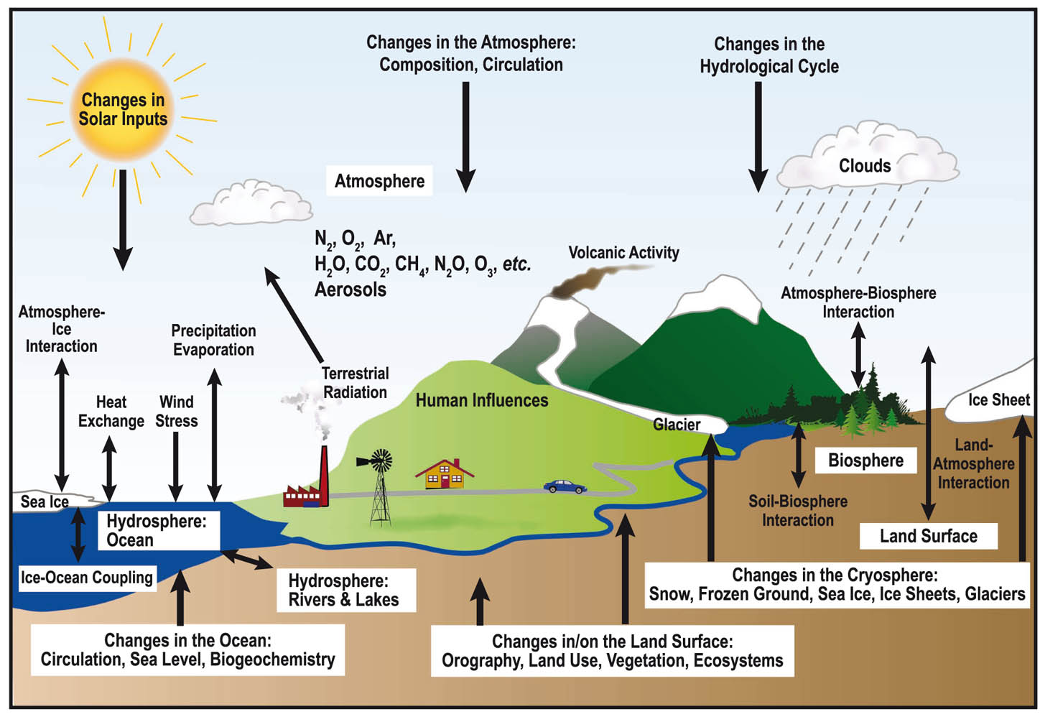
Definition of climate
Climate is now more and more defined in a wider sense as the description of the whole climate system.
Figure: IPCC(2007)
Chapter 1 Page 4

Slide 5
The atmosphere
Composition and temperature
In most cases, dry air can be considered as a perfect gas.
The amount of water vapour in the air at saturation is strongly dependent on temperature.
Saturation vapour pressure over water surface as a function of the temperature.
Chapter 1 Page 5

Slide 6
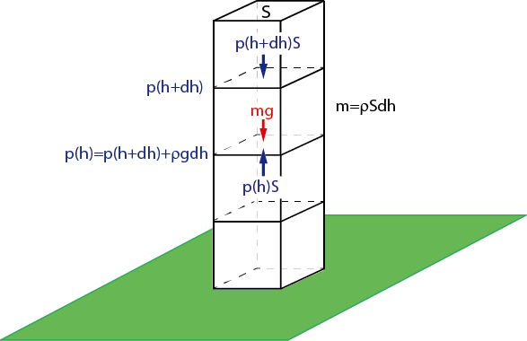
The atmosphere
Vertical profile
The atmosphere is generally close to hydrostatic equilibrium.
Balance of gravity and pressure forces on a small element of surface S and height dh. The increase in pressure between h+dh and h is equal to the weight of the element divided by its surface.
Chapter 1 Page 6

Slide 7
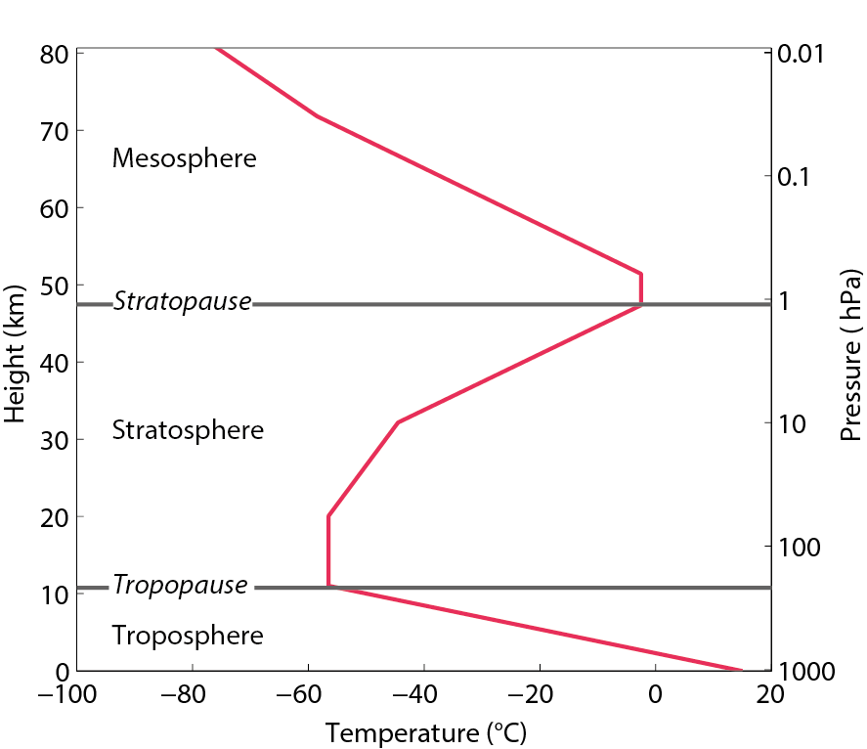
The atmosphere
Vertical profile
In the troposphere, the temperature decreases with height.
Typical temperature profile in the atmosphere as a function of the height (or of the pressure).
The global mean value of the lapse rate Γ in the troposphere is about 6.5 K km⁻¹.
Chapter 1 Page 7

Slide 8
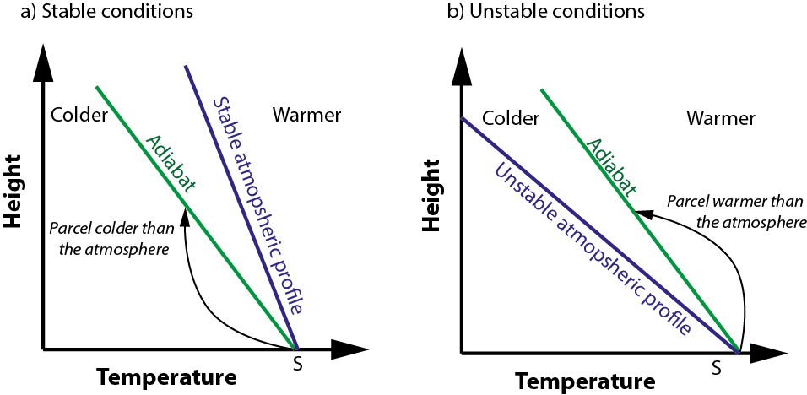
The atmosphere
The lapse rate determines the vertical stability of the atmosphere.
Chapter 1 Page 8

Slide 9
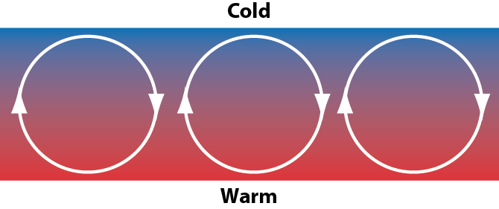
The atmosphere
General circulation of the atmosphere
Importance of “convective” motion at various scales
Schematic representation of convection in a fluid heated from below and cooled from above.
Chapter 1 Page 9

Slide 10
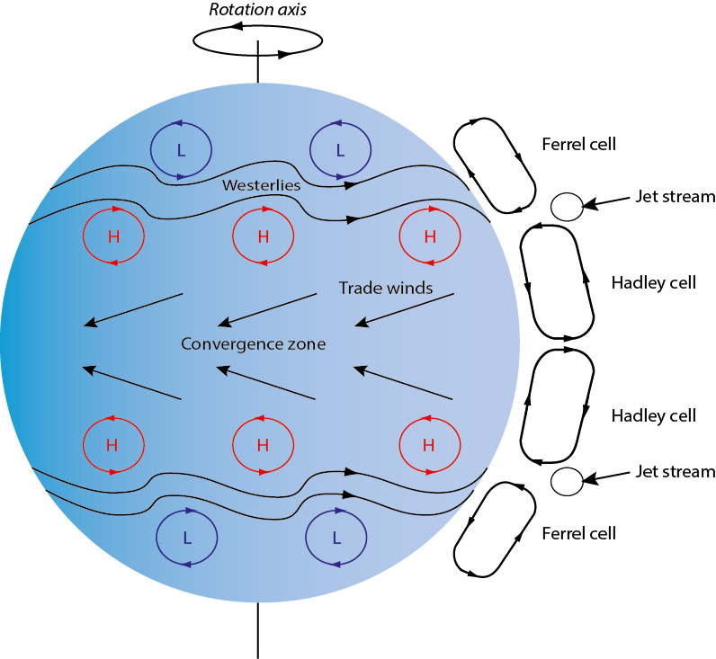
The atmosphere
General circulation of the atmosphere
Schematic representation of the annual mean general atmospheric circulation.
Chapter 1 Page 10

Slide 11
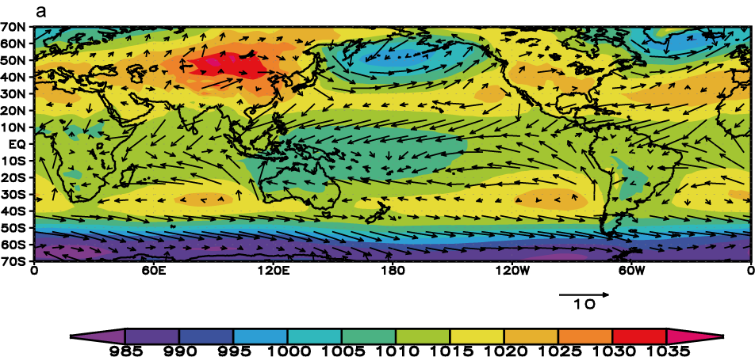
The atmosphere
General circulation of the atmosphere
10m winds (arrows, in m/s) and sea level pressure (colours, in hPa) averaged over December, January, and February.
Chapter 1 Page 11

Slide 12
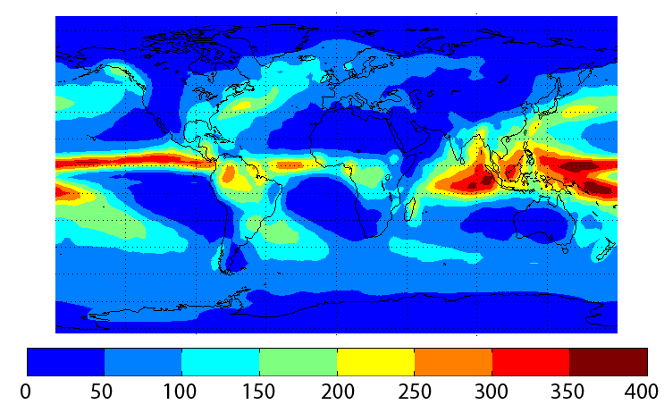
The atmosphere
Precipitation
Annual mean precipitation in cm per year
Chapter 1 Page 12

Slide 13
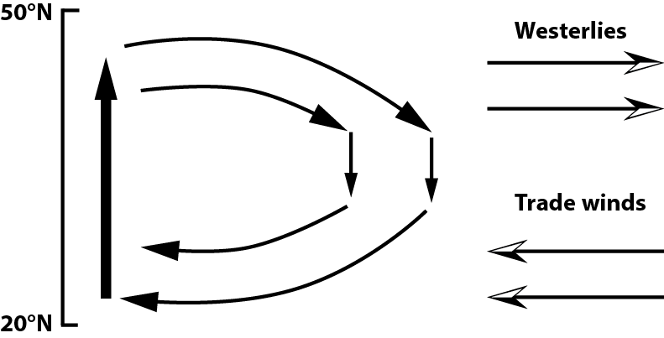
The ocean
Oceanic circulation at surface: role of the wind
Coast
Oceanic gyre
Western boundary current
Schematic representation of the wind-driven circulation at mid-latitudes
Chapter 1 Page 13

Slide 14
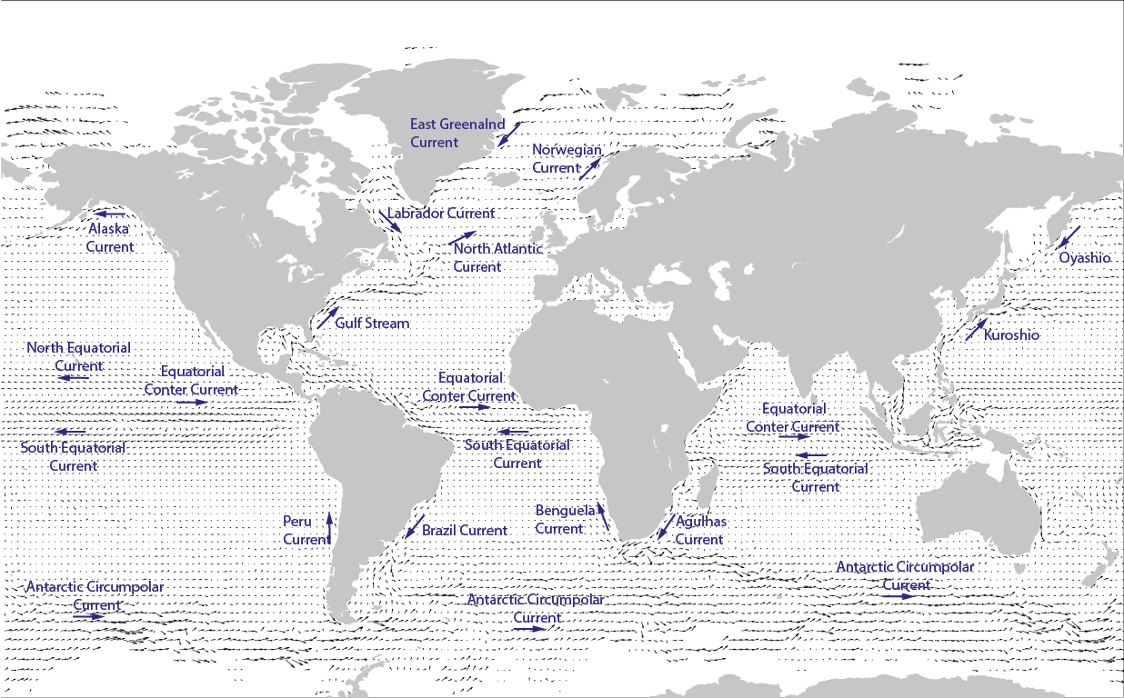
The ocean
Oceanic circulation at surface: role of the wind
Surface currents derived from satellite-tracked surface drifting buoy observations
Chapter 1 Page 14

Slide 15
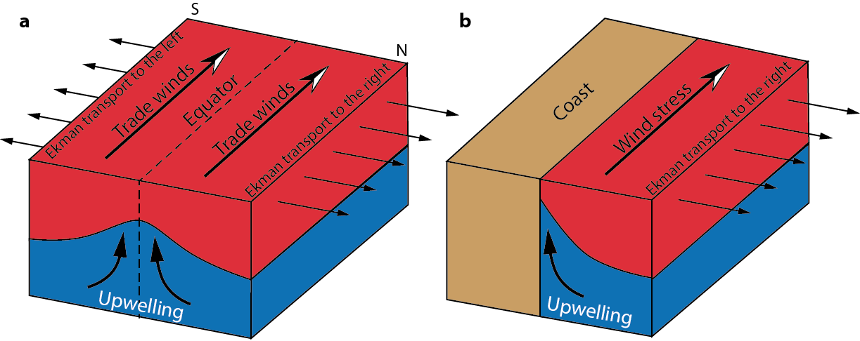
The ocean
Role of the wind in upwelling
Coastal upwelling in the Northern Hemisphere
Equatorial upwelling
Chapter 1 Page 15

Slide 16
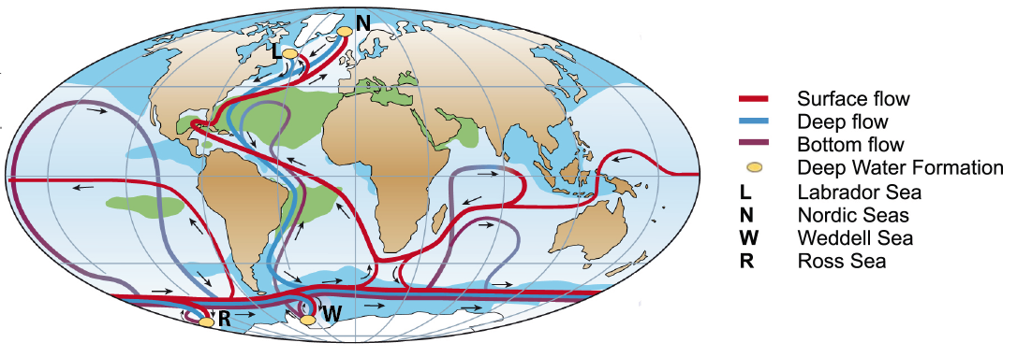
The ocean
The global thermohaline circulation
Figure based on Rahmstorf (2002) and Kuhlbrodt et al. (2007).
Chapter 1 Page 16

Slide 17
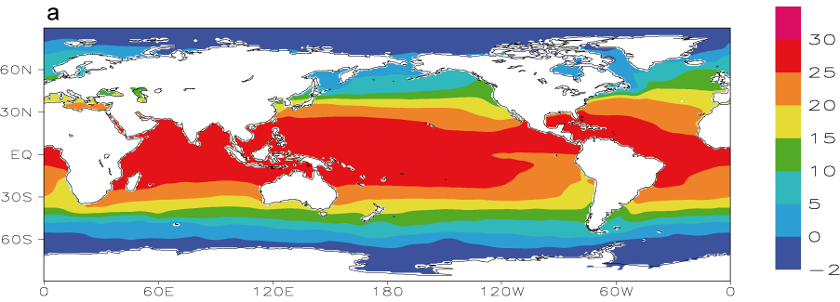
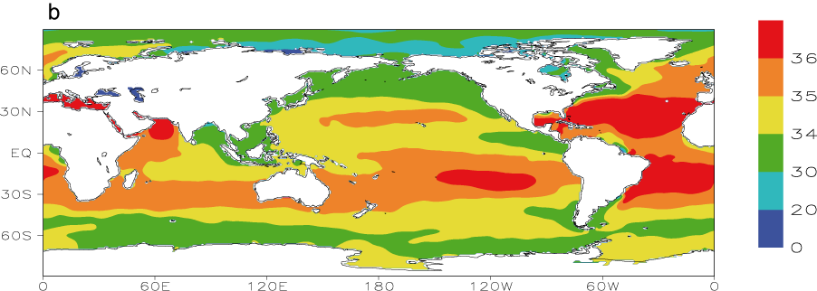
The ocean
Temperature and salinity
Annual mean sea surface temperature (°C)
Annual mean sea surface salinity (psu)
Chapter 1 Page 17

Slide 18
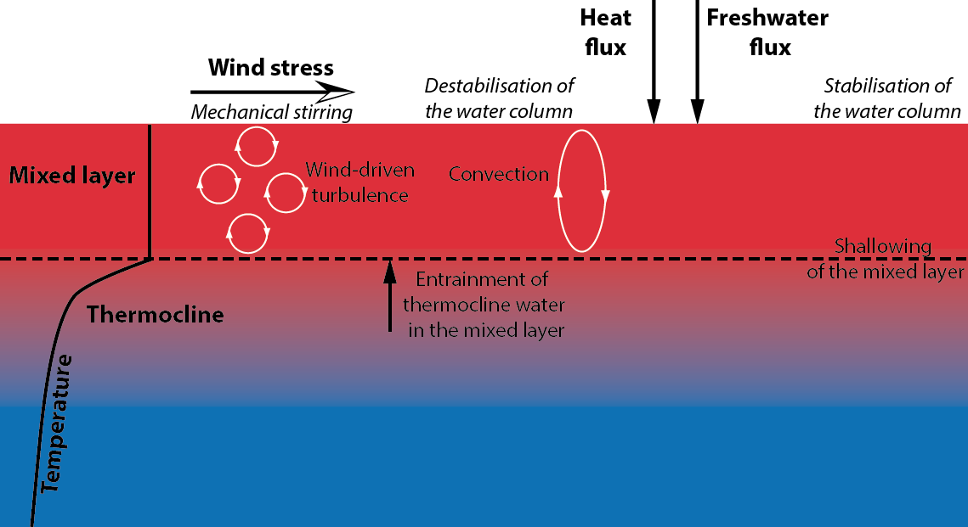
The ocean
Dynamics of the surface layer
Schematic illustration of the processes governing the time development of the mixed layer depth
Chapter 1 Page 18

Slide 19
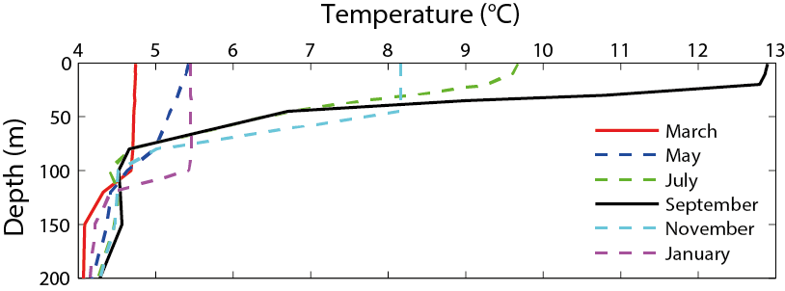
The ocean
Dynamics of the surface layer
Monthly mean temperature profiles at a mid-latitude site in the Northern Hemisphere (50° N, 145° W).
Chapter 1 Page 19

Slide 20
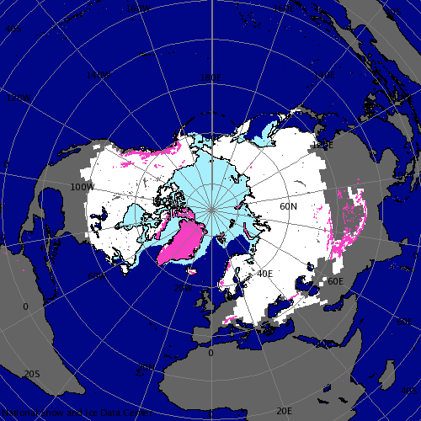
The cryosphere
The cryosphere includes sea ice, lake ice, ice sheets, ice caps, glaciers, permafrost.
The distribution of sea ice, snow and land ice in January in the Northern Hemisphere. Source: Atlas of the Cryosphere, National Snow and Ice Data Center (NSIDC), http://nsidc.org/data/atlas/
Chapter 1 Page 20

Slide 21
The land surface and the terrestrial biosphere
The topography, the surface type, the distance to the coast strongly influence the climate.
Land surface albedo from Moderate Resolution Imaging Spectroradiometer (MODIS) satellite data.
Chapter 1 Page 21

