Slide 1
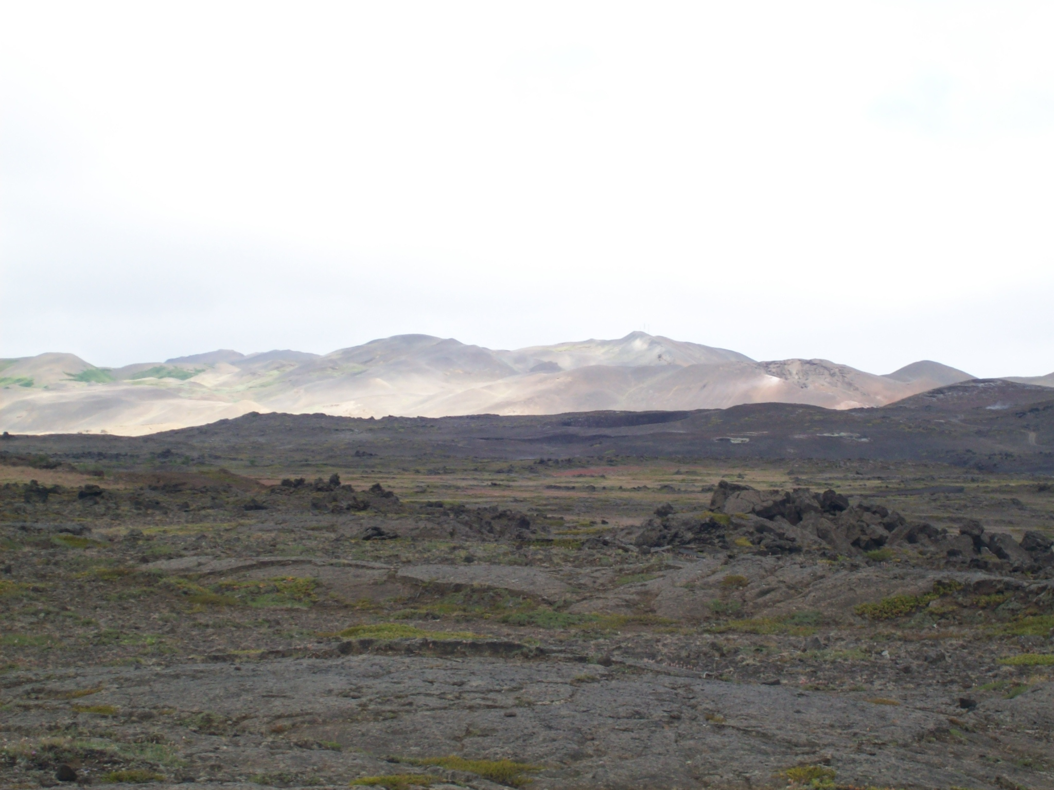
Chapter 6
Future climate changes
Climate system dynamics and modelling Hugues Goosse

Slide 2
Outline
Methods used to estimate future climate changes.
Description of the main results at different timescales.
Interpretation and limitations of the predictions.
Chapter 6 Page 2

Slide 3
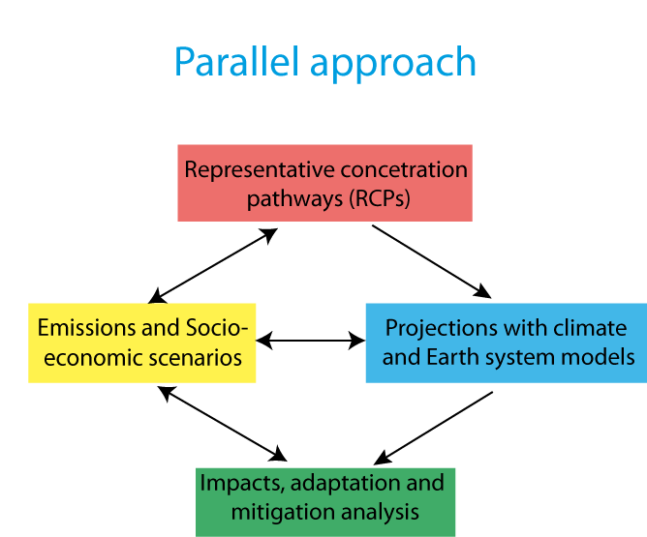
Scenarios
  Scenarios for future changes in external forcing have to be selected.
  Representative concentration pathways (RCP) scenarios provide a large range of future change in radiative forcing.
Chapter 6 Page 3

Slide 4
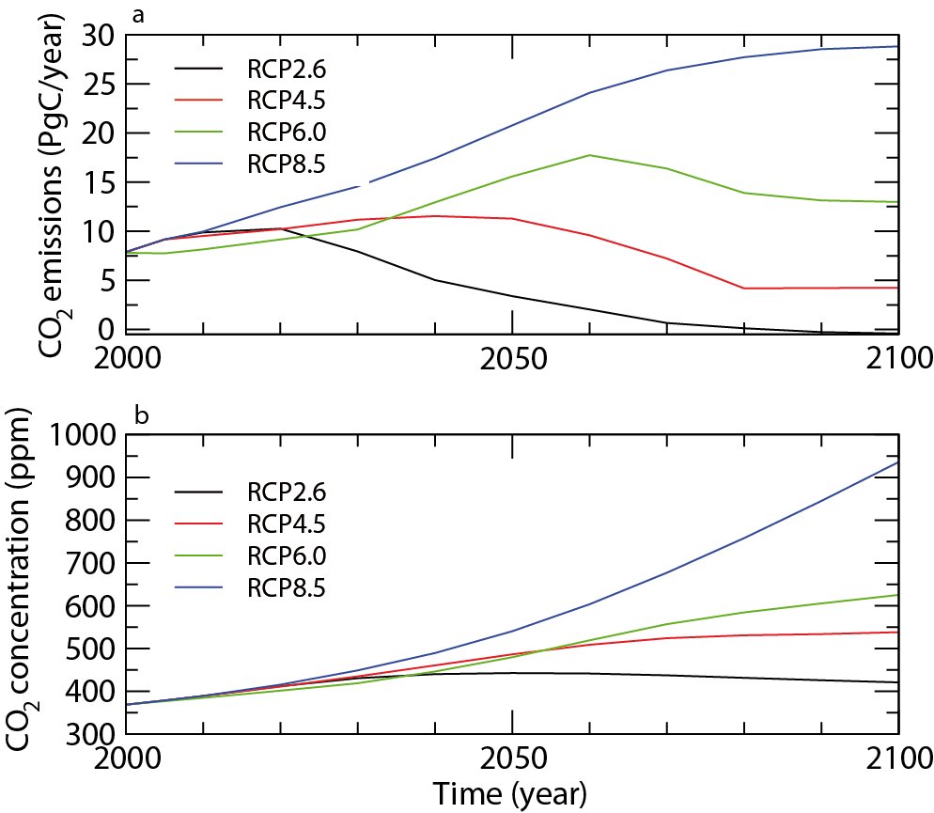
Scenarios
  RCP scenarios provide estimates for future concentration of greenhouse gases, aerosols, land use changes
  Global emission (in PgC per year) and (b) atmospheric concentration of CO₂ (in ppm) in four RCP scenarios.

Slide 5
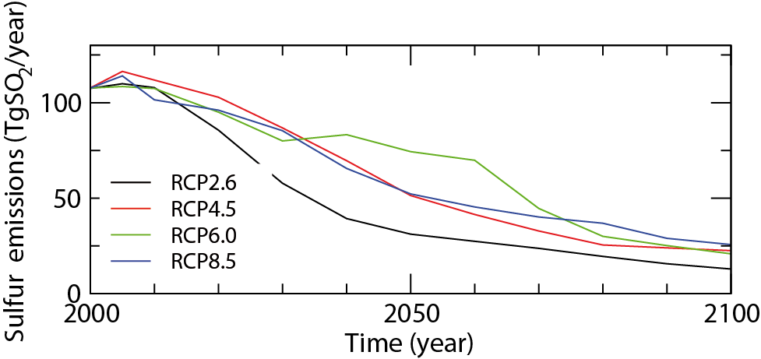
Scenarios
  SRES scenarios provide estimates for future concentration of greenhouse gases, aerosols, land use changes
  Global emissions of sulphur oxide in four RCP scenarios (in TgSO₂ per year).
Chapter 6 Page 5

Slide 6
Decadal predictions and projections
  Projection: goal = estimate the response to the forcing
  Boundary condition problem
  Predictions: goal = estimate the response to the forcing and the contribution of internal variability (the fraction which is predictable)
  Predictions must be initialised using observations.
  Mix of initial and boundary condition problem
Chapter 6 Page 6

Slide 7
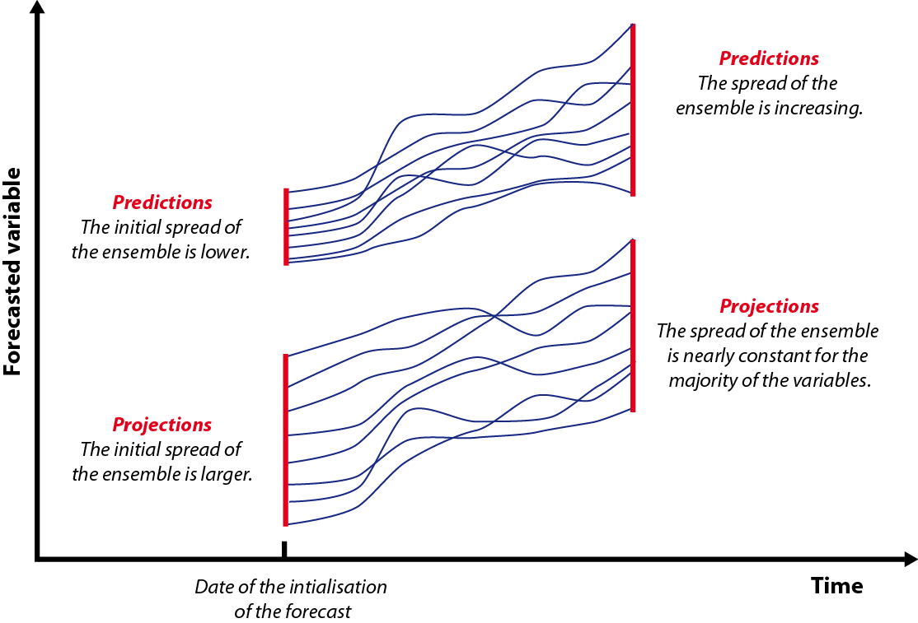
Decadal predictions and projections
  Schematic representation of the difference between projections and predictions using one model and one scenario.
Chapter 6 Page 7

Slide 8
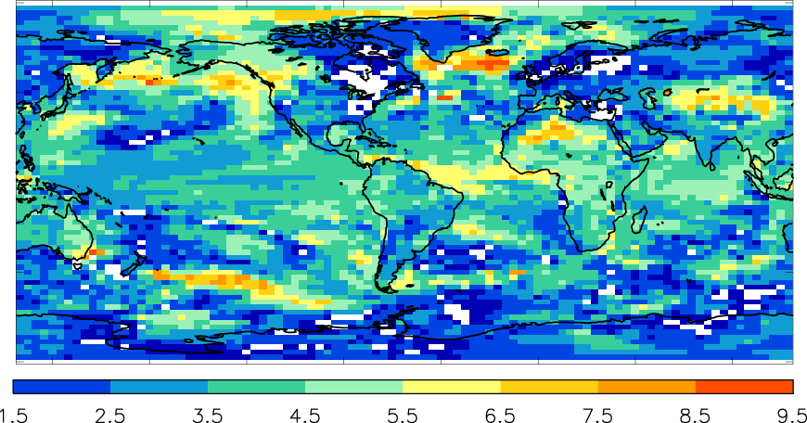
Decadal predictions and projections
  Predictability at decadal timescale is limited.
  The number of years during which the difference between the surface temperatures obtained in initialized and uninitialized simulations is significant at the 90% level. Figure from Smith et al. (2013).
Chapter 6 Page 8

Slide 9
Changes in global mean surface temperature
  The magnitude of the surface warming is strongly different in the RCP scenarios, showing the potential impact of mitigation policies.
  Time series of global annual mean surface air temperature anomalies (relative to 1986–2005) from an ensemble of model simulations performed in the framework of CMIP5. Figure from Collins et al. (2013).
Chapter 6 Page 9

Slide 10
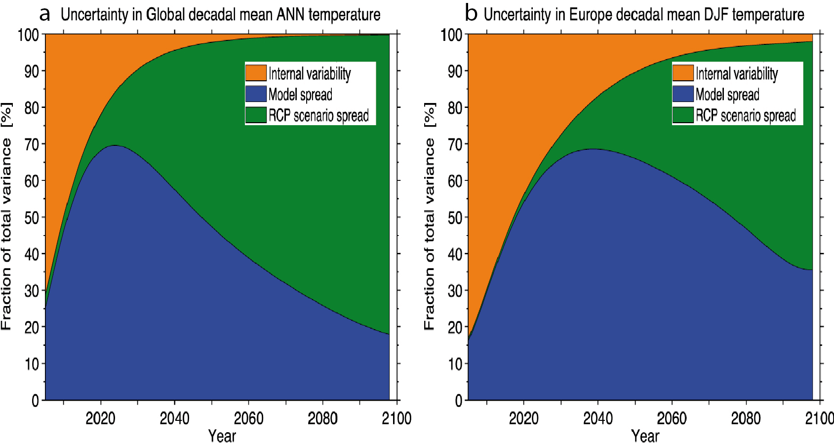
Changes in global mean surface temperature
  The uncertainty can be related to the scenario, the internal variability and the model spread.
  The fraction of total variance in decadal mean surface air temperature projections explained by the three components of total uncertainty is shown for (a) a global average of annual mean temperature and (b) winter (December-January-February) mean in Europe. Figure from Kirtman et al. (2013) based on Hawkins and Sutton (2009).
Chapter 6 Page 10

Slide 11
Spatial distribution of surface temperature changes
  Multi-model mean of surface temperature change for the scenarios RCP2.6 and RCP8.5 in 2081–2100 relative to 1986-2005. Hatching indicates regions where the multi model mean change is less than one standard deviation of internal variability. Stippling indicates regions where the multi model mean change is greater than two standard deviations of internal variability and where 90% of models agree on the sign of the change. Figure from Stocker et al. (2013)
Chapter 6 Page 11

Slide 12
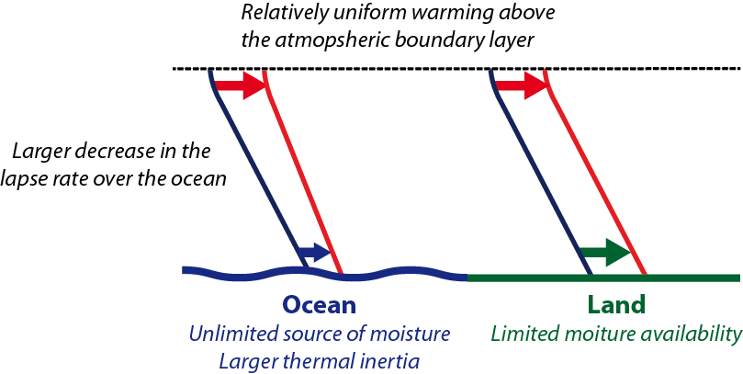
Spatial distribution of surface temperature changes
  The land/sea contrast in the warming is around 1.5 for all the scenarios .
  Schematic representation of mechanisms influencing the land-sea contrast at global and regional spatial scales (modified from Joshi et al. 2013).
Chapter 6 Page 12

Slide 13
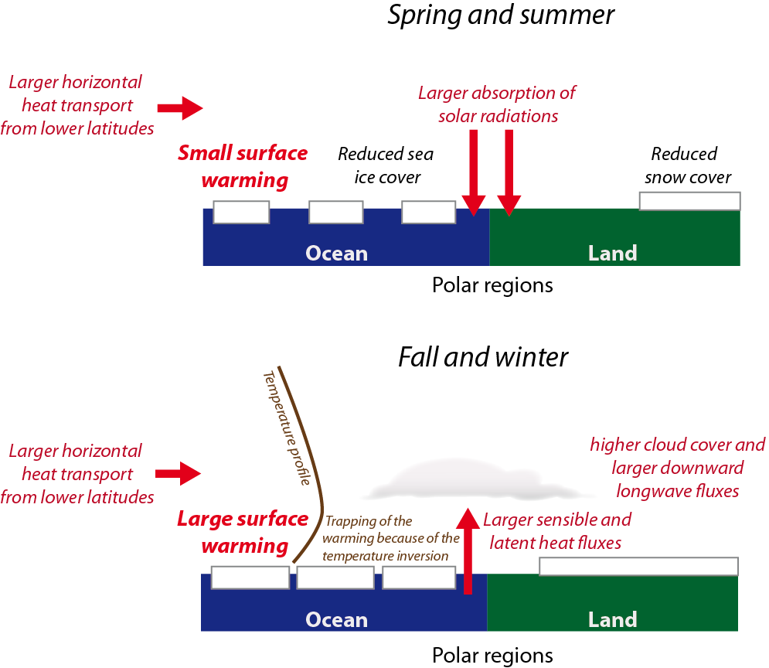
Spatial distribution of surface temperature changes
  The Arctic amplification (polar amplification) is a bit higher than 2 .
  Some processes potentially playing a role in the polar amplification
Chapter 6 Page 13

Slide 14
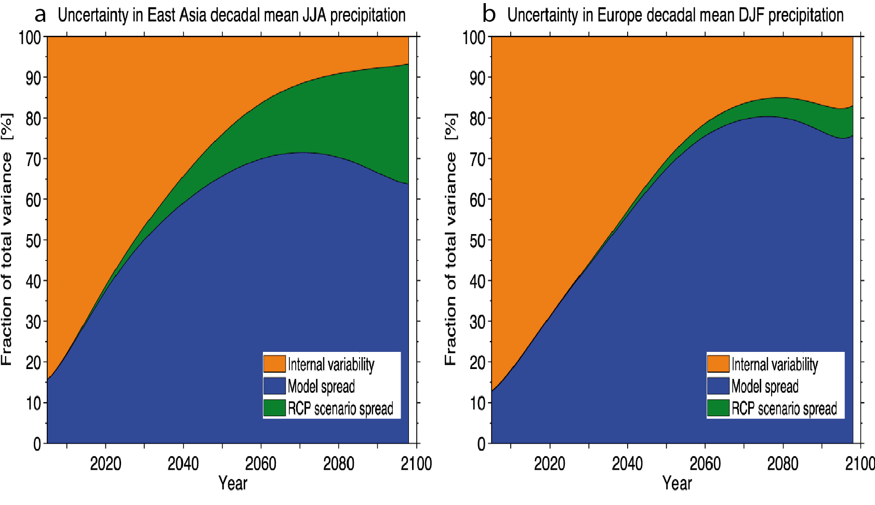
The spatial distribution of precipitation changes
  The water content of the atmosphere increases of about 7 % / °C.
  The precipitation increases at a rate of about 1-3% / °C
  The fraction of total variance in decadal mean projections of precipitation changes explained by the three components of total uncertainty. Figure from Kirtman et al. (2013) based on Hawkins and Sutton (2009)
Chapter 6 Page 14

Slide 15
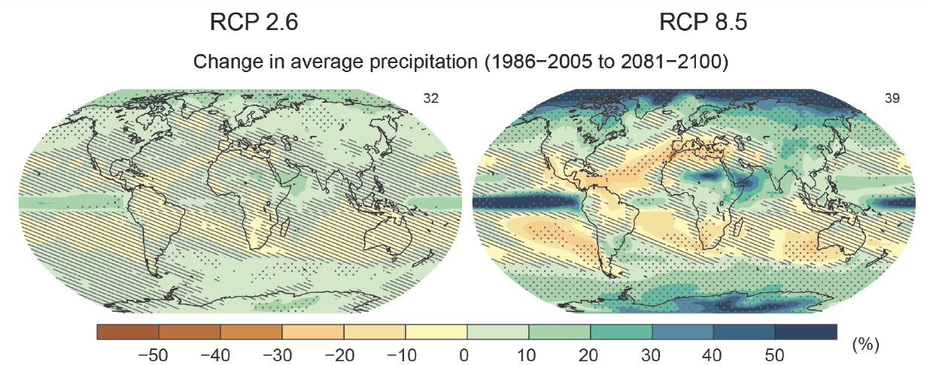
The spatial distribution of precipitation changes
  Some changes can be interpreted as an amplification of the existing differences in precipitation minus evaporation (P-E), often referred to as the wet-get-wetter and the dry-get-dryer response .
  Multi-model mean of average percent change in mean precipitation for the scenarios RCP2.6 and RCP8.5 in 2081–2100 relative to 1986-2005. Figure from IPCC (2013).
Chapter 6 Page 15

Slide 16
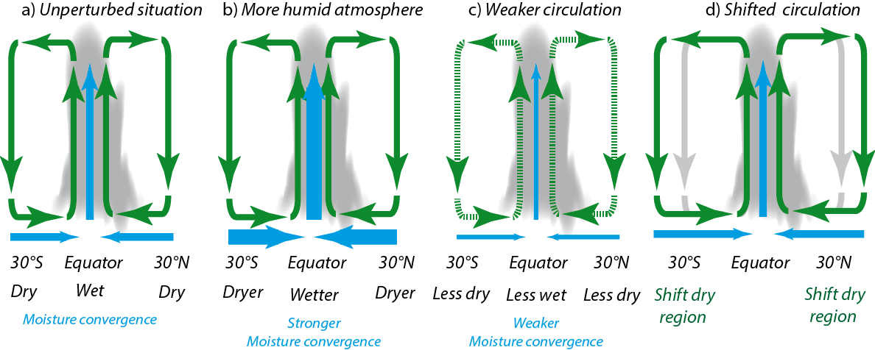
The spatial distribution of precipitation changes
  Circulation changes also have an impact on precipitation.
  Schematic representation of the changes in precipitation associated with the Hadley cell due to an increase in specific humidity, a reduction in the strength of the overturning circulation and a shift in the location of the subsidence.
Chapter 6 Page 16

Slide 17
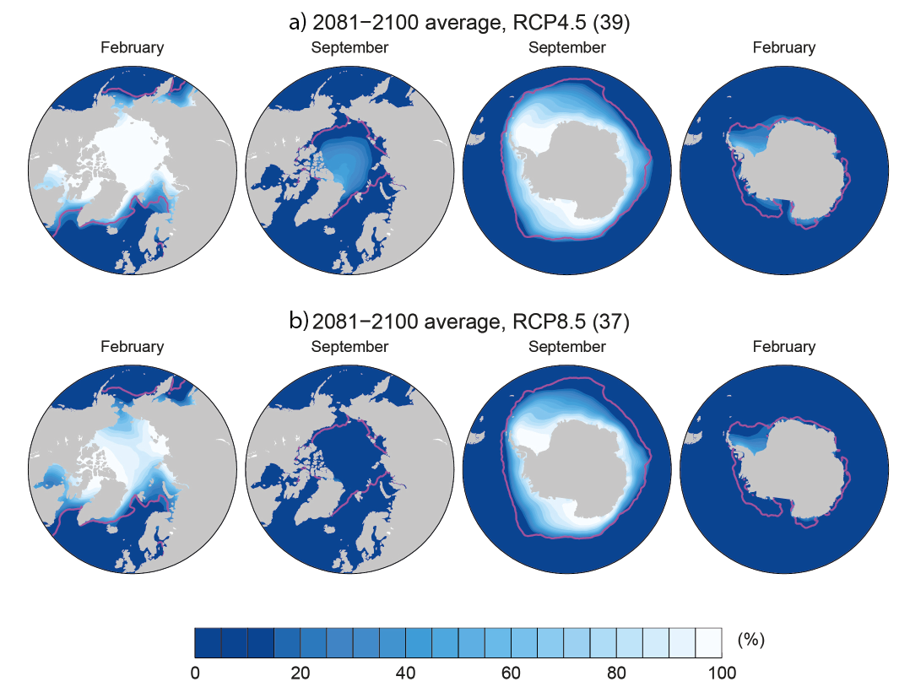
Changes in sea ice
  Changes are larger in summer in the Arctic.
  February and September CMIP5 multi-model mean sea ice concentrations (%) in the Northern and Southern Hemispheres for the period 2081–2100 under (a) RCP4.5 and (b) RCP8.5. The pink lines show the observed 15% sea ice concentration limits averaged over 1986–2005 (Comiso and Nishio, 2008). Figure from Collins et al. (2013)..

Slide 18
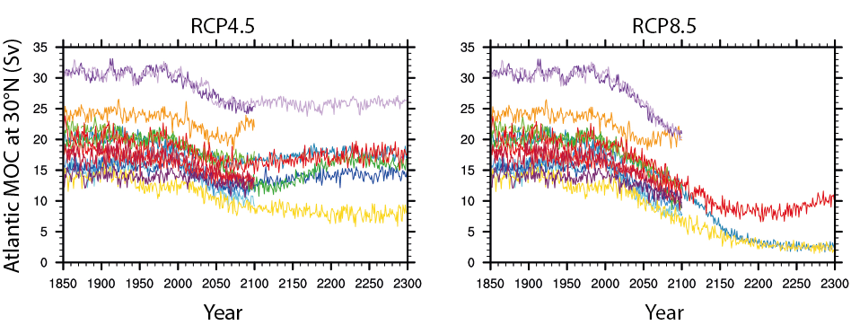
Changes in the thermohaline circulation
  The maximum of the Atlantic meridional overturning circulation (AMOC) in the North Atlantic decreases by about 35% over the 21st century in RCP8.5.
  The changes in the Atlantic meridional overturning circulation (MOC) at 30°N (in Sv=10⁶ m³ s⁻¹). Figure from Collins et al. (2013)
Chapter 6 Page 18

Slide 19
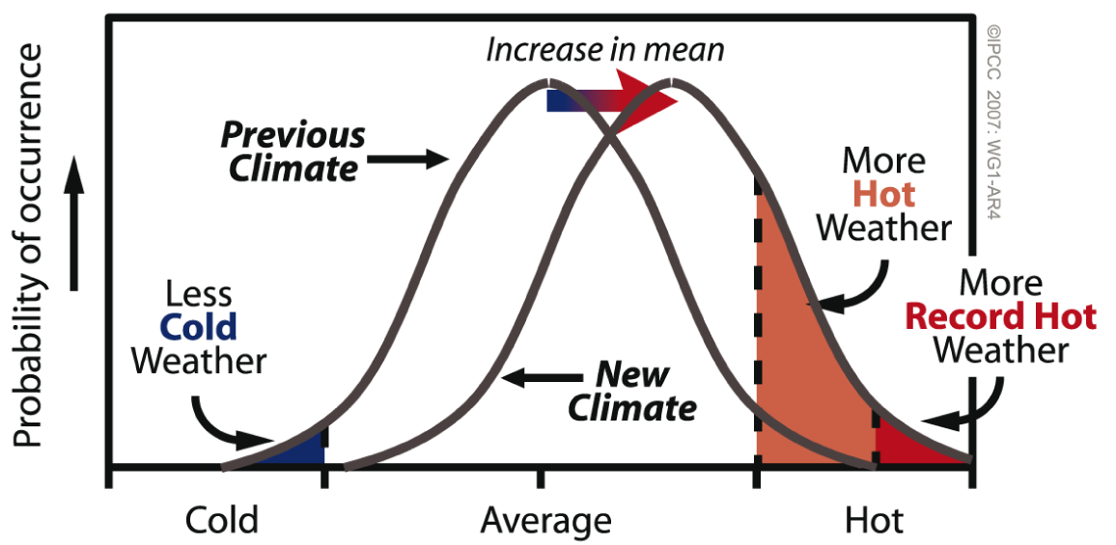
Changes in climate extremes
  A temperature rise increases the probability of very warm days and decreases the probability of very cold days.
  Schematic diagram showing the effect of a mean temperature increase on extreme temperatures, for a normal temperature distribution. Figure from Solomon et al. (2007).
Chapter 6 Page 19

Slide 20
Changes in climate extremes
  The intensity of precipitation extreme is proportional to the humidity changes and it increases at a rate of about 7 % per °C.
  Projected percent changes in the annual maximum five-day precipitation accumulation over the 2081–2100 period relative to 1981–2000 in the RCP8.5 scenario from the CMIP5 models. Figure from Collins et al. (2013).
Chapter 6 Page 20

Slide 21
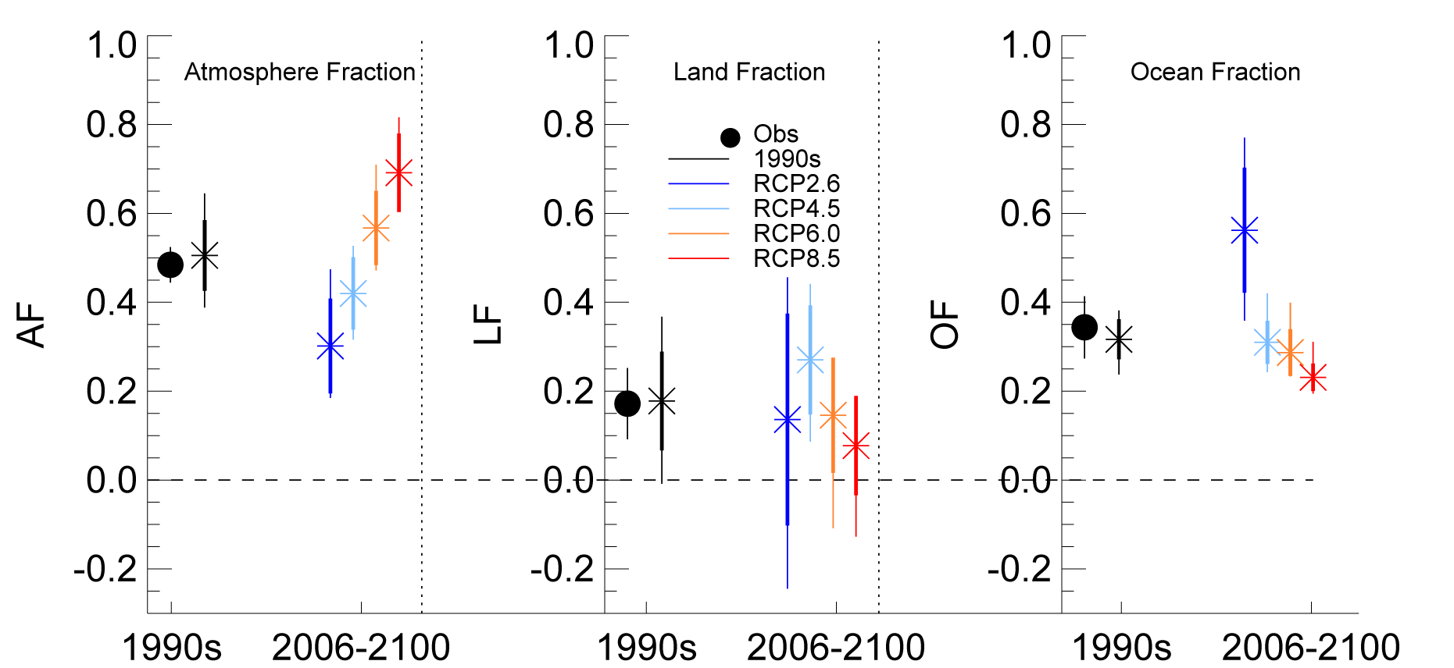
Changes in the carbon cycle
  The fraction of carbon remaining in the atmosphere will change in the future.
  Multi-model changes in atmospheric, land and ocean fraction of fossil fuel carbon emissions. The fractions are defined as the changes in storage in each component (atmosphere, land, ocean) divided by the fossil fuel emissions derived from each CMIP5 simulation for the 4 RCP scenarios. Solid circles show the observed estimates for the 1990s. Figure from Ciais et al. (2013).
Chapter 6 Page 21

Slide 22
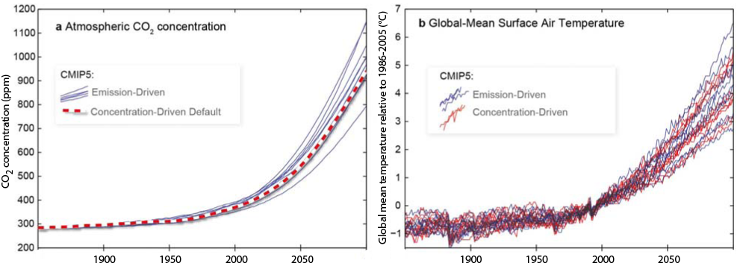
Changes in the carbon cycle
  The changes in the carbon cycle are a key source of uncertainty in climate projections.
  Simulated changes in atmospheric CO₂ concentration and global averaged surface temperature (°C) for the RCP8.5 scenario when CO₂ emissions are prescribed to the ESMs as external forcing (blue). Also shown (red) is the simulated warming from the same ESMs when directly forced by atmospheric CO₂ concentration (red dotted line). Figure from Collins et al. (2013).
Chapter 6 Page 22

Slide 23
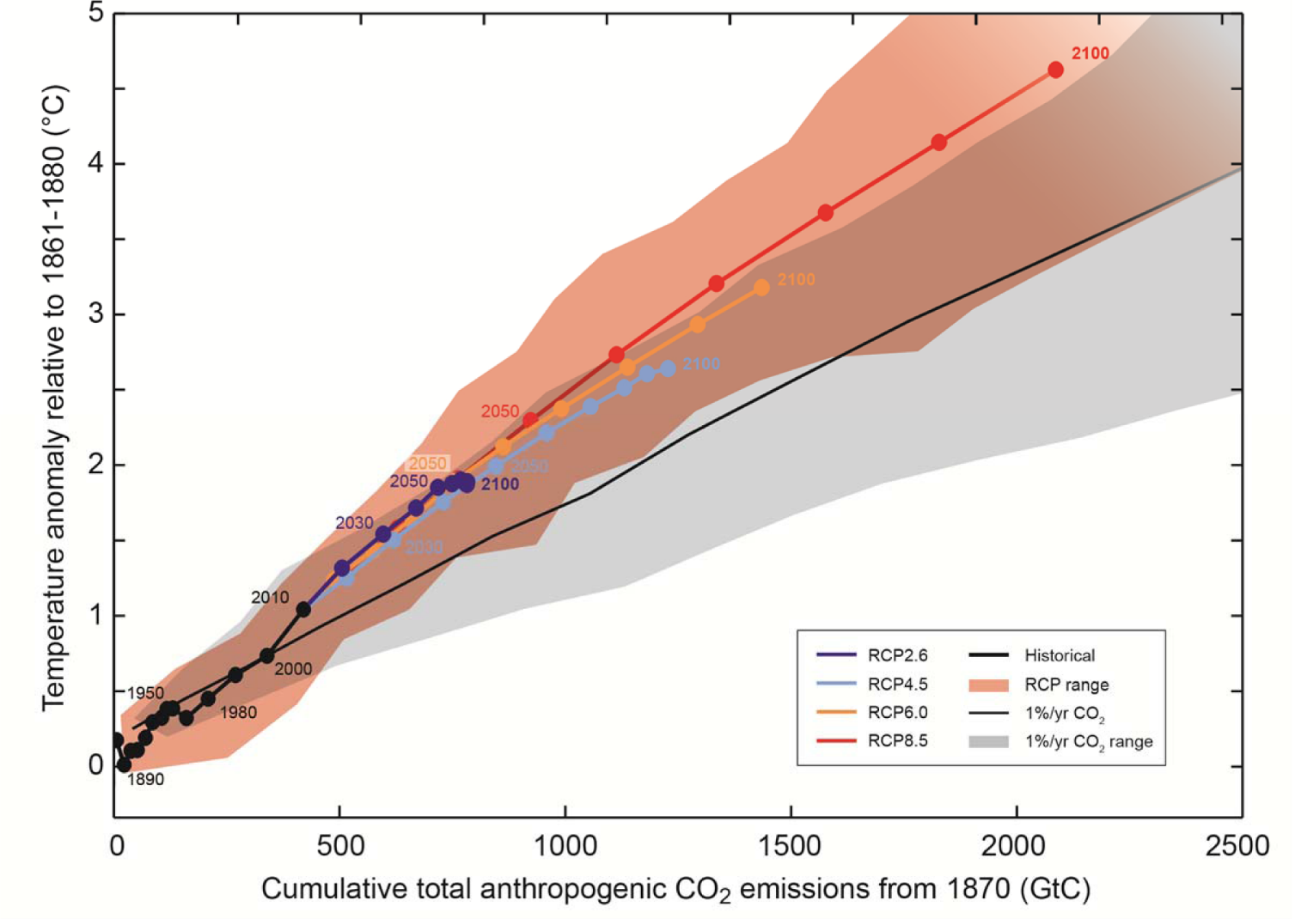
Changes in the carbon cycle
  It is possible to roughly estimate the maximum amount of anthropogenic CO₂ that can be released to maintain the global mean temperature below a chosen target.
  Global mean surface temperature increase as a function of cumulative total global CO₂ emissions. All values are given relative to the 1861−1880 base period. Figure from IPCC (2013).
Chapter 6 Page 23

Slide 24
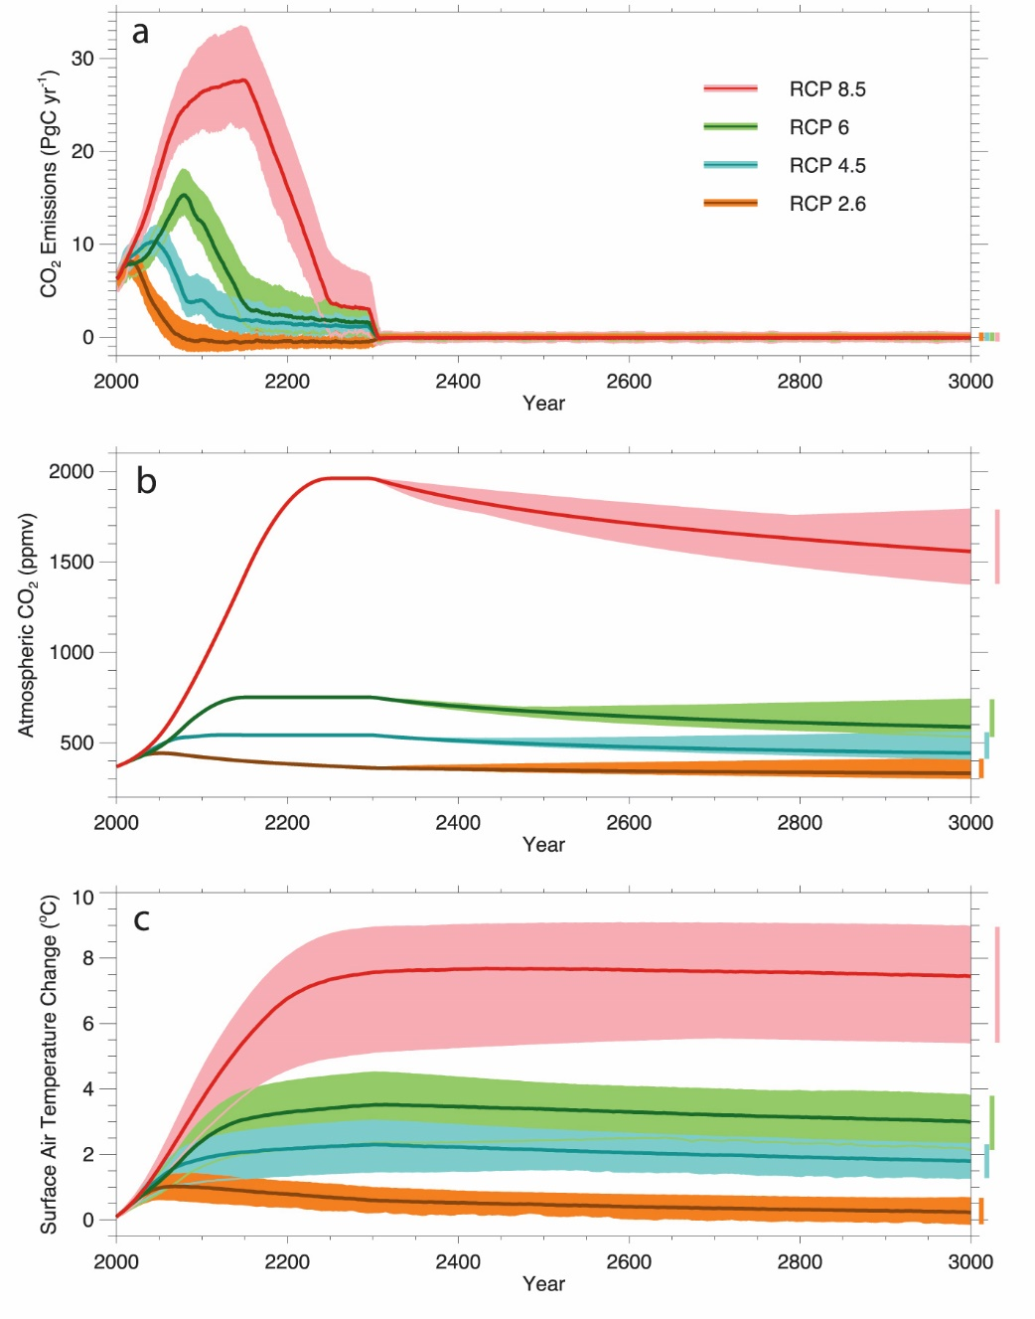
Long-term climate changes: carbon cycle
  As the deep ocean is not in equilibrium, the carbon uptake continues during the whole of the third millennium.
  CO₂ emissions, atmospheric CO₂ concentration and global mean surface air temperature relative to the years 1986-2005 in seven intermediate-complexity models. Figure from Zickfield et al. (2013)
Chapter 6 Page 24

Slide 25
Long-term climate changes: carbon cycle
  Despite the decrease in radiative forcing, the temperature remains more or less stable.
  CO₂ emissions, atmospheric CO₂ concentration and global mean surface air temperature relative to the years 1986-2005 in seven intermediate-complexity models. Figure from Zickfield et al. (2013)
Chapter 6 Page 25

Slide 26
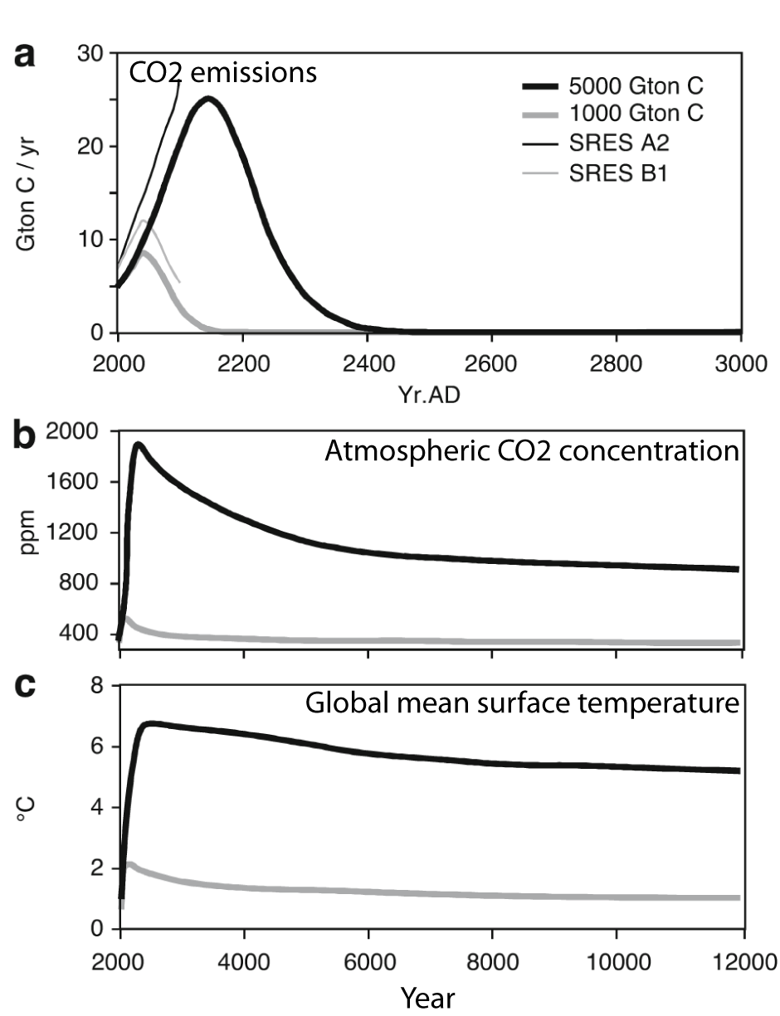
Long-term climate changes: carbon cycle
  On millennial timescale, interactions with sediments lead to a decrease in the atmospheric CO₂ concentration.
  The response of the climate model of intermediate complexity CLIMBER-2 to moderate (1,000 Gton C) and large (5,000 Gton C) total fossil fuel emissions. (a) Emissions scenarios and reference SRES scenarios (B1 and A2). (b) Simulated atmospheric CO2 (ppm). (c) Simulated changes in global annual mean air surface temperature (°C). Figure from Archer and Brovkin (2008)
Chapter 6 Page 26

Slide 27
Long-term climate changes: carbon cycle
Processes responsible for long term change in atmospheric CO₂ concentration:
Atmosphere-ocean equilibrium
Carbonate compensation
Interactions with rocks (weathering)
Chapter 6 Page 27

Slide 28
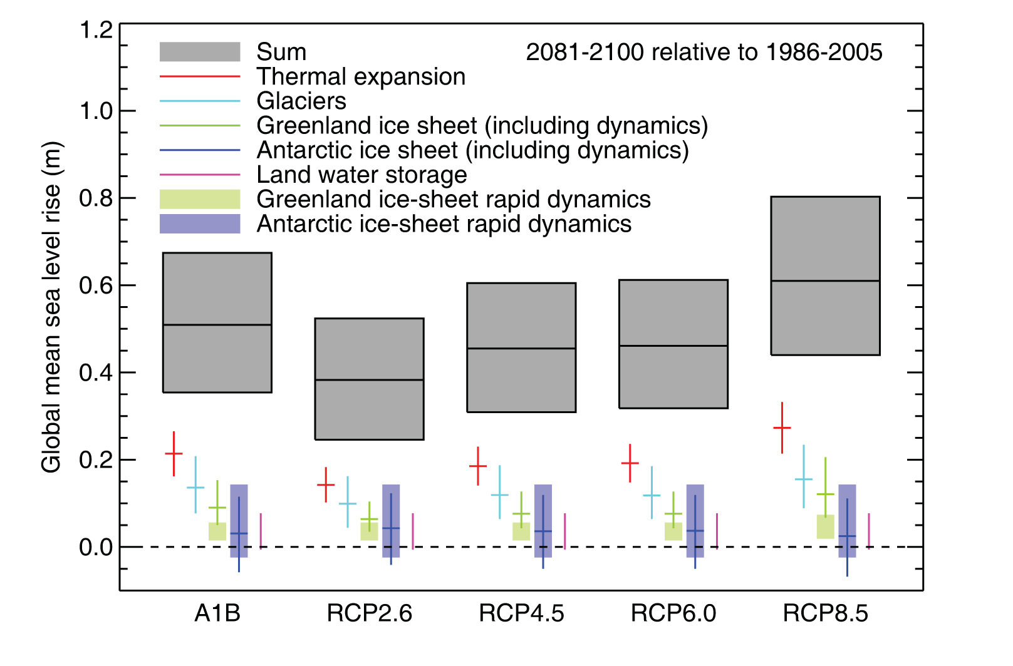
Long-term climate changes: sea level and ice sheets
  Projections of sea level rise for the 21st century.
  Projections from process-based models with median and likely range (66 %) for global-mean sea level rise and its contributions in 2081–2100 relative to 1986–2005 for the four RCP scenarios and scenario SRES A1B. Figure from Church et al. (2013).
Chapter 6 Page 28

Slide 29
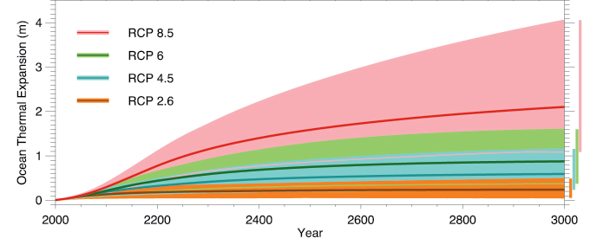
Long-term climate changes: sea level and ice sheets
  Thermal expansion takes place during the whole 3rd millennium.
  Changes in sea level (relative to the years 1986-2005) caused by thermal expansion, in seven intermediate-complexity models in idealised prolongations of RCP scenarios displaying a reduction of CO₂ emissions to zero after 2300. Figure from Zickfield et al. (2013).
Chapter 6 Page 29

Slide 30
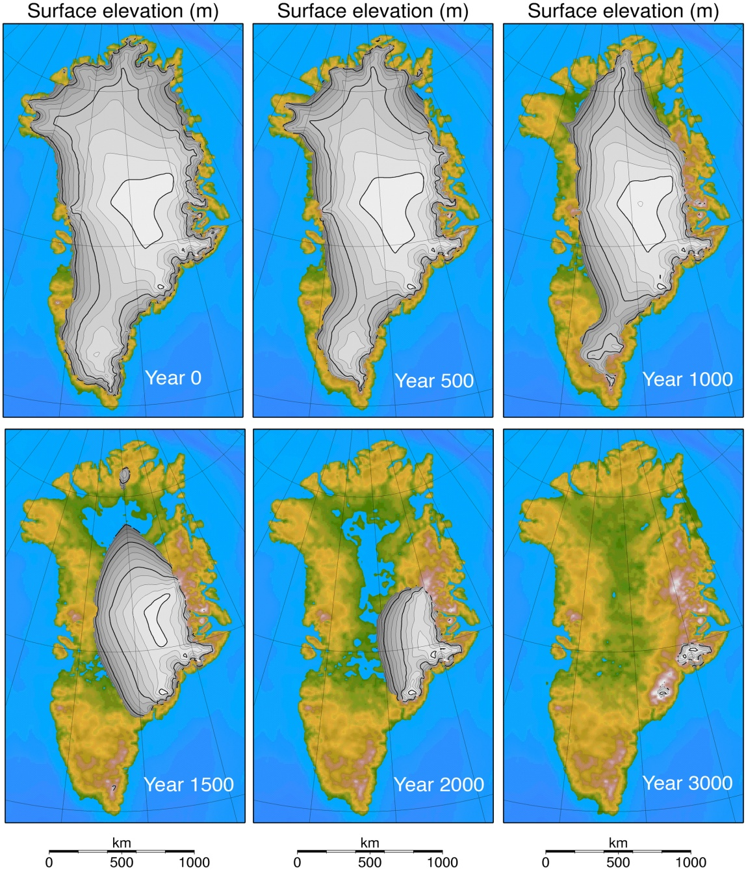
Long-term climate changes: sea level and ice sheets
  The melting of Greenland ice sheet would take millennia.
  A complete melting of the Greenland ice sheet would lead then to a sea level rise of about 7m.
  Greenland ice-sheet evolution in a scenario in which the CO₂ concentration is maintained at a constant level equal to 4 times the pre-industrial value (4 times CO₂ scenario) during 3000 years. Shown is surface elevation. Figure from Huybrechts et al. (2011).
Chapter 6 Page 30

Slide 31
Abrupt climate changes
  The most classical example of abrupt change is related to the Atlantic meridional overturning circulation.
  Good physical understanding
  Rapid changes in the past attributed to transitions in AMOC
  Consistent Model response to freshwater perturbation
  But still many uncertainties.
Chapter 6 Page 31

Slide 32
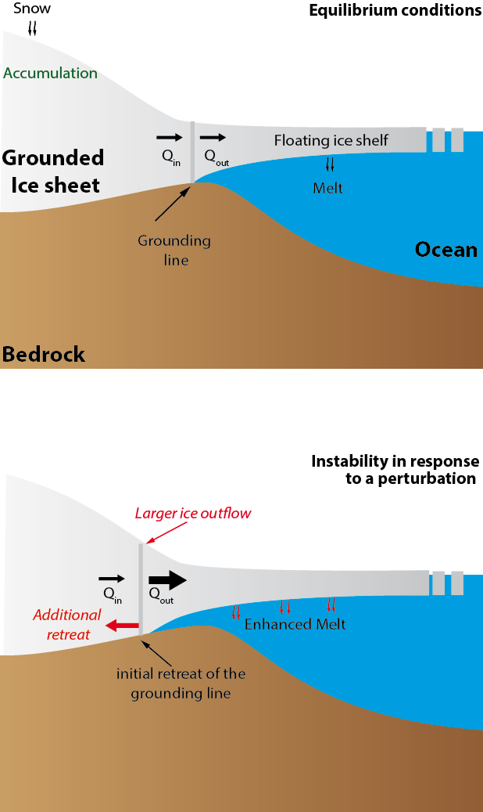
Abrupt climate changes
  The marine ice sheet instability.
Chapter 6 Page 32

